Slide 1

AgriSynergy: Integrated Agricultural Management System
Kameswara Krishna Sai Praneeth
Venkata Deepak Vishwanadha
Yashwanth Behara

Slide 2
Introduction
Comprehensive Solution: Integrates Farms, Distribution, Analytics, and Marts for holistic agricultural management.
Key Roles: Data Analysts for data-driven insights, Crop Planners for strategic planting, and Warehouse Coordinators for seamless inventory management and deliveries.
Enhanced Efficiency: Collective efforts optimize operations, ensuring sustainability and success in modern agriculture.

Slide 3
Enterprises, Organizations, Roles…
Enterprises: Farms, Distribution, Analytics, Marts.
Organizations: Crop Planning, Harvest Operations Organization, Regional Distribution Organization, Data Analytics Farm Management Organization, Logistics Organization, Customer Relation Organization.
Enhanced Efficiency: Crop Planner, Harvest Technician, Warehouse Manager, Data Analyst, Delivery Driver ,Sales Associates.

Slide 4
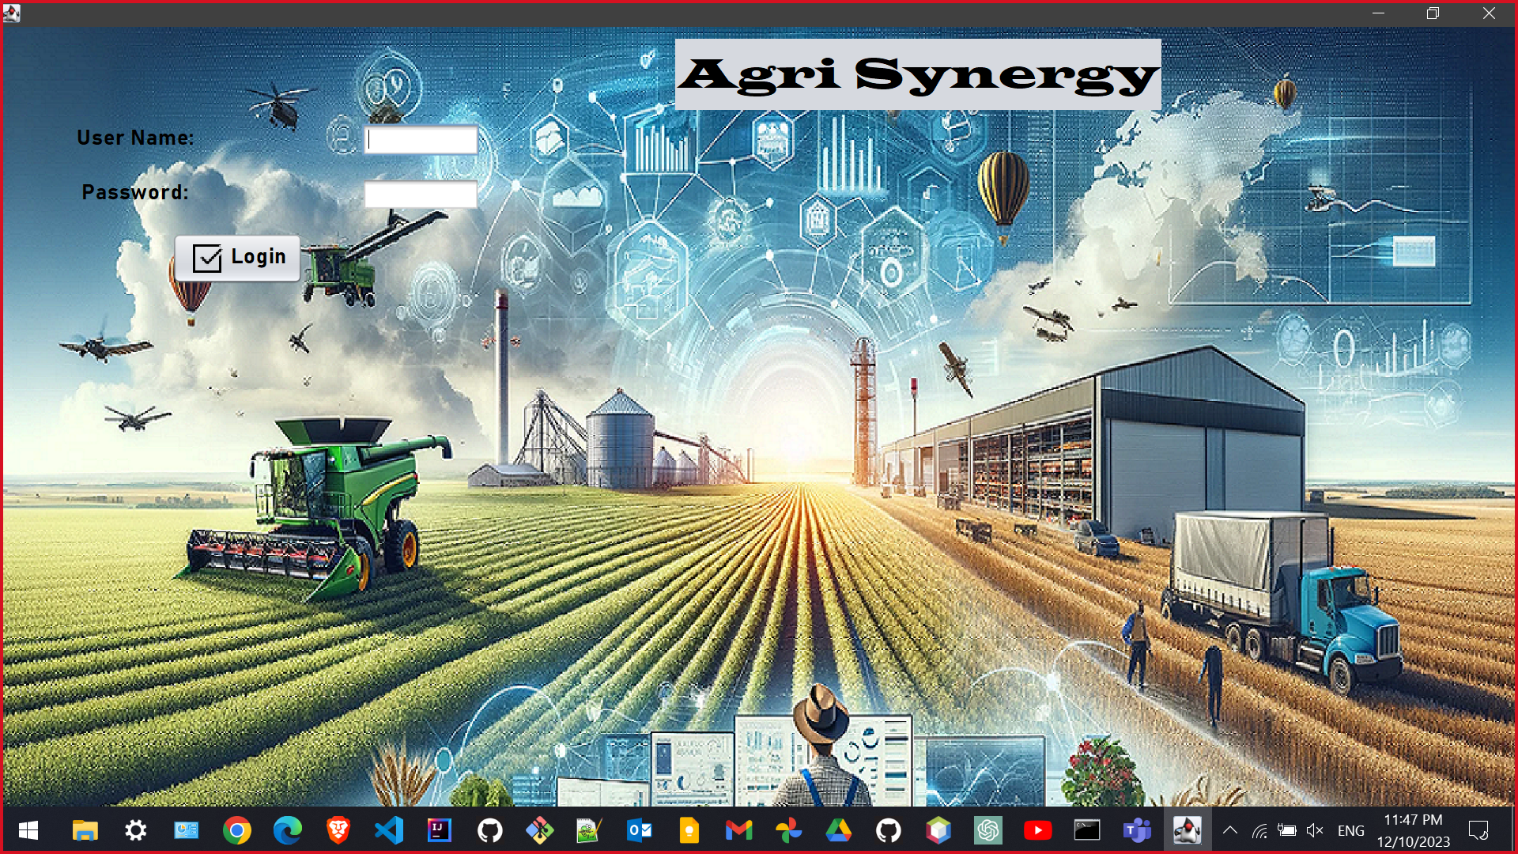

Slide 5
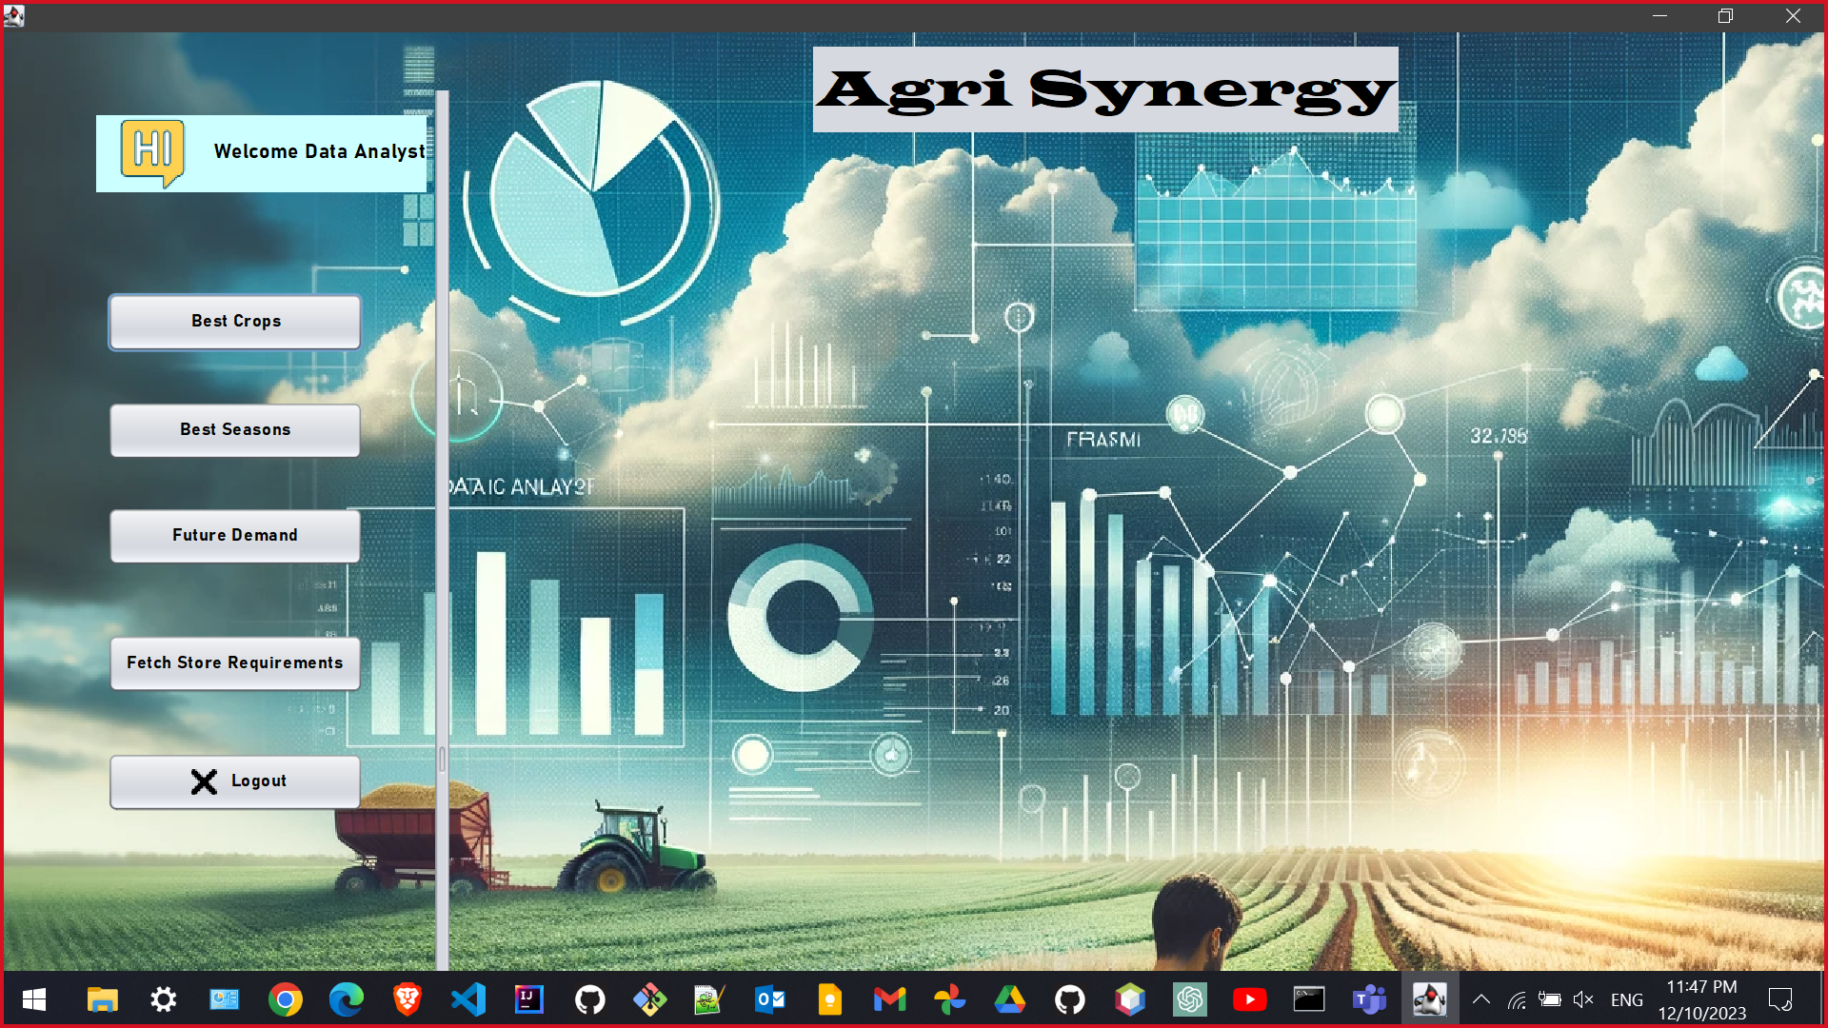

Slide 6
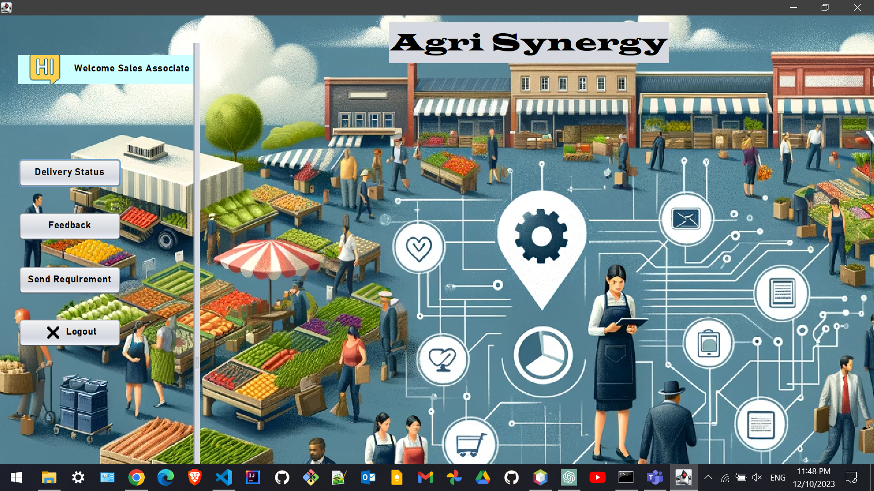

Slide 7
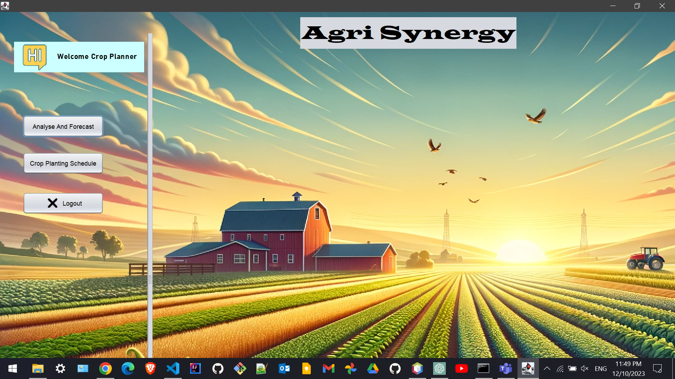

Slide 8
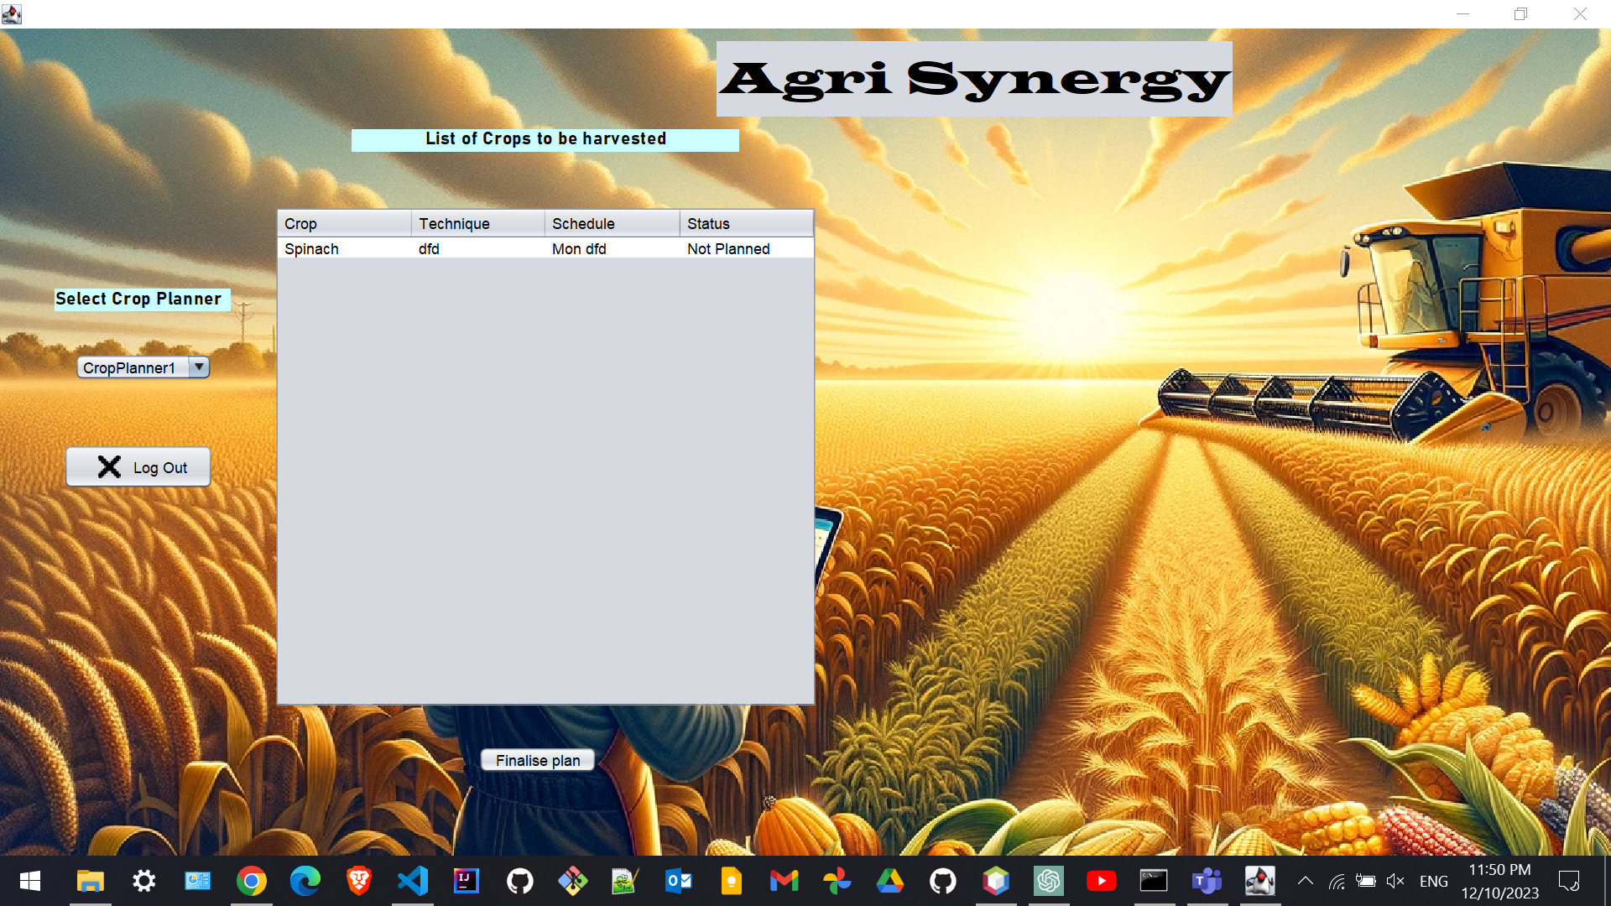

Slide 9
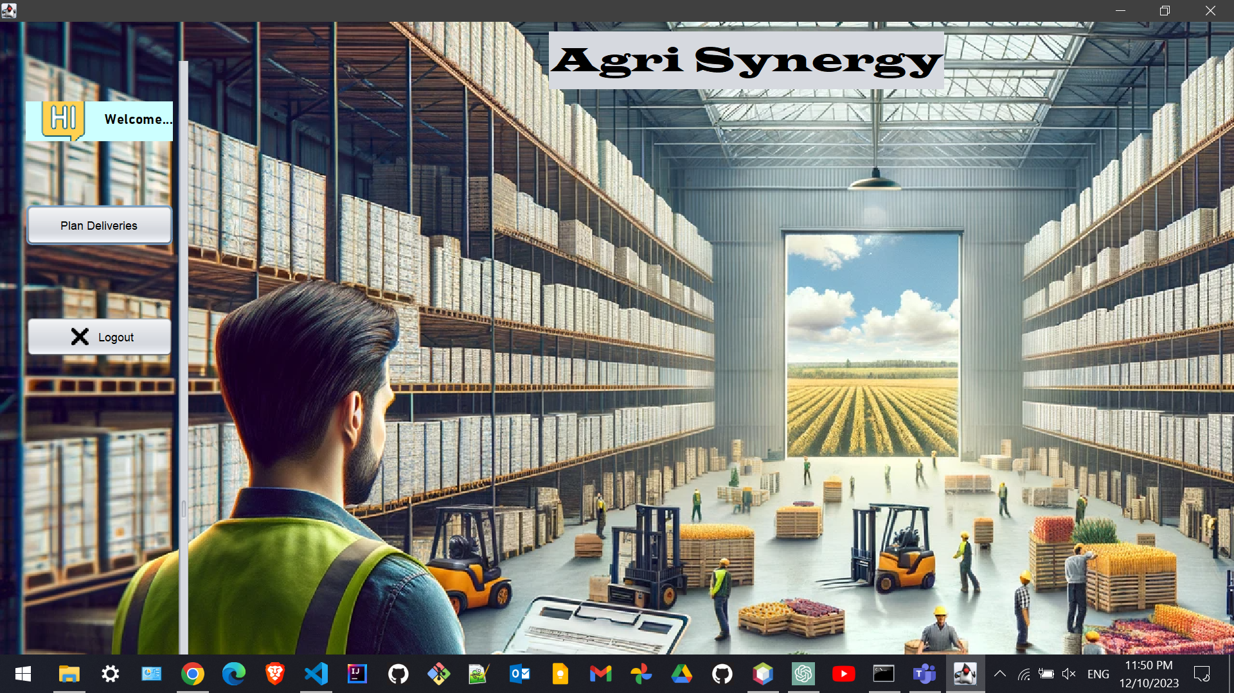

Slide 10
A Sustainable Tomorrow…
Through the collective efforts of Warehouse Coordinators, Delivery Drivers, Sales Associates, and Harvest Technicians, the system promotes sustainability, paving the way for a successful and eco-conscious future in modern agriculture.

Slide 11
An Endgame Team Presentation…
Thank you

